Slide 1
Unit OS4: Scheduling and Dispatch
4.6. Lab description

Slide 2
Copyright Notice
© 2000-2005 David A. Solomon and Mark Russinovich
These materials are part of the Windows Operating System Internals Curriculum Development Kit, developed by David A. Solomon and Mark E. Russinovich with Andreas Polze
Microsoft has licensed these materials from David Solomon Expert Seminars, Inc. for distribution to academic organizations solely for use in academic environments (and not for commercial use)

Slide 3

Labs for 4.2
The following is a superset of the labs presented in module
“4.2. Windows Processes and Threads”

Slide 4
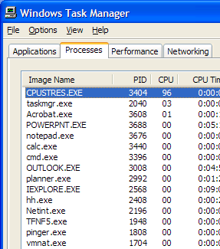
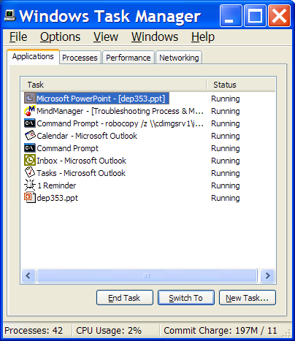
Task Manager: Processes vs Applications Tabs
Processes tab: List of processes
Applications tab: List of top level visible windows
“Running” means waiting for window messages
Right-click on a window and select “Go to process”
Notes:
The built-in Windows Task Manager provides a quick list of the processes running on the system. You can start Task Manager in one of three ways: (1) press Ctrl+Shift+Esc, (2) right-click on the taskbar and select Task Manager, or (3) press Ctrl+Alt+Delete and click the Task Manager button. Once Task Manager has started, click the Processes tab to see the list of running processes. Notice that processes are identified by the name of the image of which they are an instance. Unlike some objects in Windows, processes can’t be given global names. To display additional details, choose Select Columns from the View menu and select additional columns to be added.

Slide 5
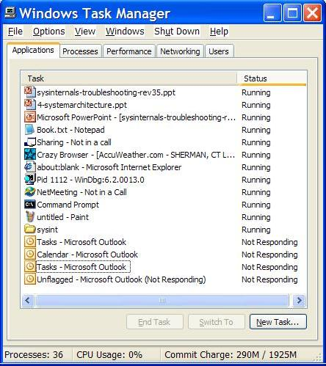
What Are Task Manager’s “Applications”?
A meaningless term at the OS level
  Not a list of processes
  Not a list of “tasks” (another meaningless term)
  It’s a list of top level visible windows in your session that meet certain criteria
What does the status column mean?
  Running:
    Windows don’t run—threads do
    Running displayed only when owning thread is waiting for a window message (e.g. not running!)
  Not Responding: not waiting for window messages
To map a window to a process, right-click on a window and select “Go to process”
Notes:
Although what you see in the Task Manager Processes tab is clearly a list of processes, what the Applications tab displays isn’t as obvious. The Applications tab lists the top-level visible windows on all the desktops in the interactive window station. (By default, there are two desktop objects—you can create more by using the Windows CreateDesktop function.) The Status column indicates whether or not the thread that owns the window is in a Windows message wait state. “Running” means the thread is waiting for windowing input; “Not Responding” means the thread isn’t waiting for windowing input (for example, the thread might be running or waiting for I/O or some Windows synchronization object). From the Applications tab, you can match a task to the process that owns the thread that owns the task window by right-clicking on the task name and choosing Go To Process.

Slide 6
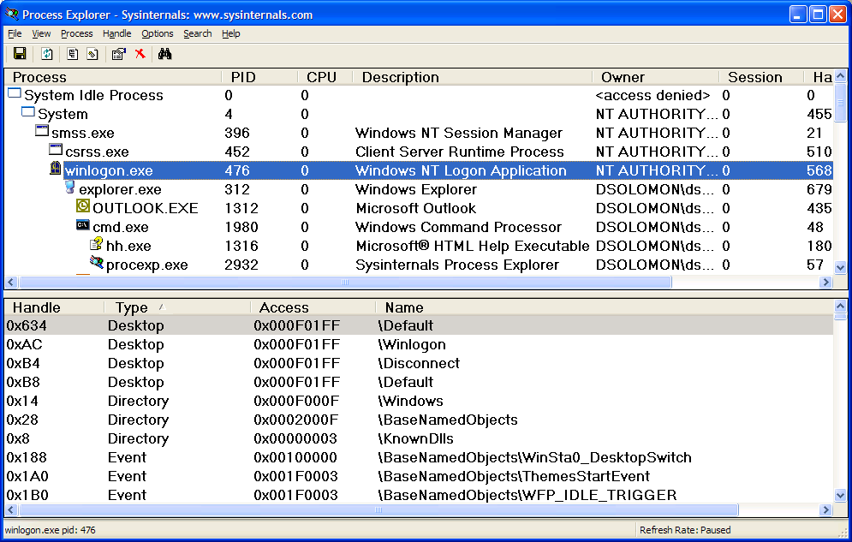
Process Explorer (Sysinternals)
“Super Task Manager”
  Shows full image path, command line, environment variables, parent process, security access token, open handles, loaded DLLs & mapped files
Notes:
Process Explorer, from www.sysinternals.com, shows more details about processes and threads than any other available tool, which is why you will see it used in a number of experiments throughout the book. The following are some of the unique things that Process Explorer shows or enables:
Full path name for the image being executed
Process security token (list of groups and privileges)
Highlighting to show changes in the process and thread list
List of services inside service-hosting processes, including display name and description
Processes that are part of a job and job details
Processes running .NET/WinFX applications and.NET-specific details (such as the list of appdomains and CLR performance counters)
Start time for processes and threads
Complete list of memory mapped files (not just DLLs)
Ability to suspend a process
Ability to kill an individual thread
Easy identification of which processes were consuming the most CPU time over a period of time (The Performance Tool can display process CPU utilization for a given set of processes, but it won’t automatically show processes created after the performance monitoring session has started.)
Process Explorer also provides easy access to information available through other tools from one central place, such as:
Process tree (with ability to collapse parts of the tree)
Open handles in a process without prior setup (The Microsoft tools to show open handles require the setting of a systemwide flag and a reboot before they can be used.)
List of DLLs (and memory-mapped files) in a process
Thread activity within a process
User-mode thread stacks (including mapping of addresses to names using the debugging tools’ symbol engine)
Kernel-mode thread stacks for system threads (including mapping of addresses to names using the debugging tools’ symbol engine)
Context switch delta (a better representation of CPU activity, as explained in Chapter 6)
Kernel memory (paged and nonpaged pool) limits (other tools show only current size)
The first time you run it, you will receive a message that symbols are not currently configured. If properly configured, Process Explorer can access symbol information to display the symbolic name of the thread start function and functions on its call stack (available by double-clicking on a process and clicking on the Threads tab). This is useful for identifying what threads are doing within a process. To access symbols, you must have the Debugging Tools installed (described later in this chapter). Then click on Options, choose Configure Symbols, and fill in the appropriate Symbols path. For more information on configuring use of the symbol server, see http://www.microsoft.com/whdc/ddk/debugging/symbols.mspx.

Slide 7
Lab: The Process List
Run Process Explorer & maximize window
Run Task Manager – click on Processes tab
Arrange windows so you can see both
Notice process tree vs flat list in Task Manager
  If parent has exited, process is left justified
Sort on first column (“Process”) and note tree view disappears
Click on View->Show Process Tree (or CTRL+T) to bring it back
Notice description and company name columns
Hover mouse over image to see full path of image
Right click on a process and choose “Google”

Slide 8
Lab: Refresh Highlighting
Change update speed to paused by pressing space bar
Run Notepad
In ProcExp, hit F5 and notice new process
Exit Notepad
In ProcExp, hit F5 and notice Notepad in red
Uses
  Understanding process startup sequences
  Detecting appearance of processes coming and going

Slide 9
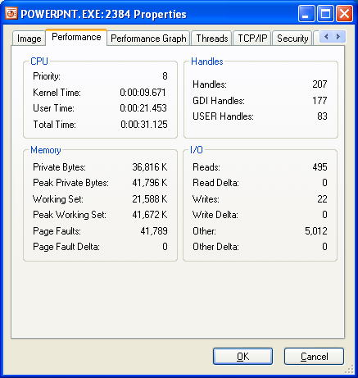
Process Performance
Click on Performance Tab of process properties
  Note: all these numbers can be configured as columns
Notes:
Where is full path.
What if process gets same pid as previous process? DO first process’ children get forcibly adopted? No.
Do “notepad fred” to show command-line arguments. Shortcut might pass arguments.
Names used in performance tab much more logical than task manager.
Security: useful for telling what groups the process belongs to. Definitive list.
Explain privileges. Example: change system time. Double click on time applet and look at it in process explorer. See rundll32.exe. If double-click on it and look at command-line, last argument is timedate.cpl. Look at security and find that the time privilege is on.
Environment tab: sometimes input to scripts or apps. PATH is one of the more important. Inherited from parent. Set DAVID=brilliant. Run paintbrush and look at it’s environment. But not in others.
Services: talk about them later.

Slide 10
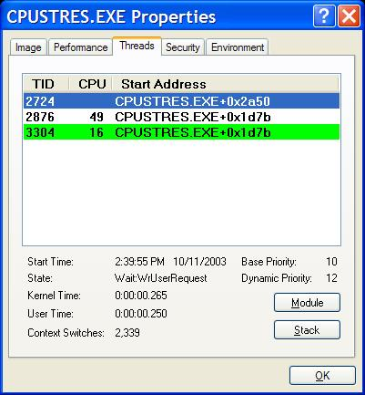
Thread Details
Process Explorer “Threads” tab shows which thread(s) are running
  Start address represents where the thread began running (not where it is now)
  Click Module to get details on module containing thread start address
Notes:
Process Explorer provides easy access to thread activity within a process. This is especially important if you are trying to determine why a process is running that is hosting multiple services (such as Svchost.exe, Dllhost.exe, Inetinfo.exe, or the System process) or why a process is hung.
To view the threads in a process, select a process and open the process properties (double-click on the process or click on the Process, Properties menu item). Then click on the Threads tab. This tab shows a list of the threads in the process. For each thread it shows the percentage of CPU consumed (based on the refresh interval configured), the number of context switches to the thread, and the thread start address. You can sort by any of these three columns.
New threads that are created are highlighted in green, and threads that exit are highlighted in red. (The highlight duration can be configured with the Options, Configure Highlighting menu item.) This might be helpful to discover unnecessary thread creation occurring in a process. (In general, threads should be created at process startup, not every time a request is processed inside a process.)
As you select each thread in the list, Process Explorer displays the thread ID, start time, state, CPU time counters, number of context switches, and the base and current priority. There is a Kill button, which will terminate an individual thread, but this should be used with extreme care.
The context switch delta represents the number of times that thread began running in between the refreshes configured for Process Explorer. It provides a different way to determine thread activity than using the percentage of CPU consumed. In some ways it is better because many threads run for such a short amount of time that they are seldom (if ever) the currently running thread when the interval clock timer interrupt occurs, and therefore, are not charged for their CPU time. For example, if you add the context switch delta column to the process display and sort by that column, you will see processes that have threads running but that also have a CPU time percentage of zero (or very small).

Slide 11
Thread Start Functions
Process Explorer can map the addresses within a module to the names of functions
  This can help identify which component within a process is responsible for CPU usage
Requires access to:
  Symbol file for that module
  Proper version of Dbghelp.dll
By default, Process Explorer looks for:
  Dbghelp.dll: in the default Windows Debugging Tools install directory
  Symbols: _NT_SYMBOL_PATH environment variable
  Can also specify with Options->Configure Symbols
Notes:
The thread start address is displayed in the form “module!function”, where module is the name of the .exe or .dll. The function name relies on access to symbol files for the module. (See “Experiment: Viewing Process Details with Process Explorer” in Chapter 1.) If you are unsure what the module is, press the Module button. This opens an Explorer file properties window for the module containing the thread’s start address (for example, the .exe or .dll).
Note For threads created by the Windows CreateThread function, Process Explorer displays the function passed to CreateThread, not the actual thread start function. That is because all Windows threads start at a common process or thread startup wrapper function (BaseProcessStart or BaseThreadStart in Kernel32.dll). If Process Explorer showed the actual start address, most threads in processes would appear to have started at the same address, which would not be helpful in trying to understand what code the thread was executing.
If properly configured, Process Explorer can access symbol information to display the symbolic name of the thread start function and functions on its call stack (available by double-clicking on a process and clicking on the Threads tab). This is useful for identifying what threads are doing within a process. To access symbols, you must have the Debugging Tools installed (described later in this chapter). Then click on Options, choose Configure Symbols, and fill in the appropriate Symbols path. For more information on configuring use of the symbol server, see http://www.microsoft.com/whdc/ddk/debugging/symbols.mspx.

Slide 12
Call Stacks
Process Explorer can also show the thread call stack
  Represents sequence of functions called
Important if start address doesn’t indicate what the thread is doing
  E.g. if it’s a generic library start routine
Function 1
Function 2
Function 3

Slide 13
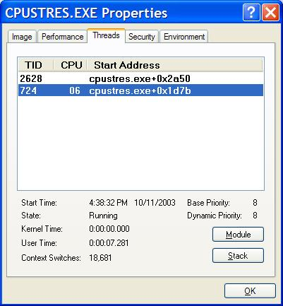
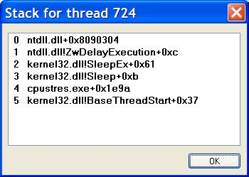
Call Stacks
Click Stack to view call stack
  Lists functions in reverse chronological order
Note that start address on Threads tab is different than first function shown in stack
  This is because all user threads start in a Windows library function which calls the programmed start address

Slide 14
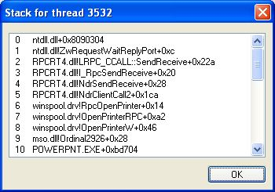
Example: Viewing Stacks
Problem: Powerpoint was hanging for 1 minute on startup
Thread stack shows waiting on a printer driver

Slide 15
Suspending Processes
Process Explorer can suspend a process
Why would you want to do this?
  You’ve started a long running job but want to pause it to do something else
    Lowering the priority still leaves it running…
  You’ve started a long download but want to have your network bandwidth temporarily
  Some multi-service system process activity is due to other processes calling upon their services
    Suspend a process that is consuming CPU time to see what that does to the system process in question

Slide 16
Lab: Suspend
Start Notepad
From a command prompt:
  Suspend Notepad process with Process Explorer
  Try to switch back to Notepad (should not respond)
  Open Task Manager and look at Notepad’s status in the applications tab ☺
  Resume Notepad

Slide 17
Process Explorer Lab: Column Selection And Username
Notice additional details show for each process (icon, description)
Click on View->Select Columns
  Add username column
Compare username column in Task Manager with Process Explorer – what is the difference?
Deselect View->Show Processes From All Users

Slide 18
Process Explorer Lab: Command Line
Double click on date/time in task bar (lower right of screen)
In Process Explorer, hit F5 to refresh
Find new process created (RUNDLL32.EXE)
Examine command line arguments
Example: cmd.exe process was consuming lots of CPU time
  Command line argument showed which .BAT file was running

Slide 19
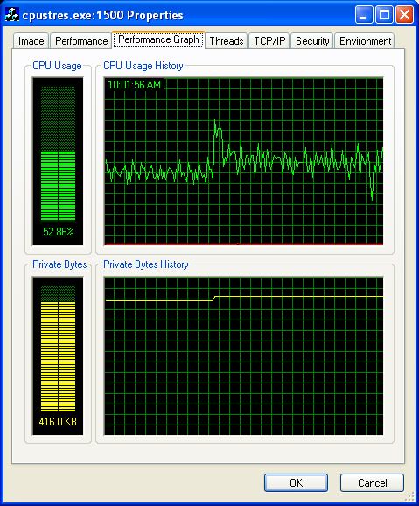

Examining CPU Time
Open process properties and look at CPU usage history on the performance graph page
Hover the mouse over a point to see the time of that value

Slide 20
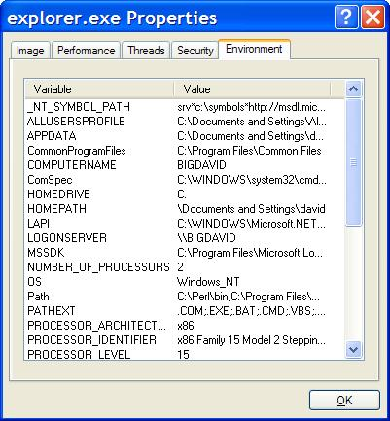
Process Explorer Lab:
Environment Variables
Click on Environment Tab of process properties
Notes:
Where is full path.
What if process gets same pid as previous process? DO first process’ children get forcibly adopted? No.
Do “notepad fred” to show command-line arguments. Shortcut might pass arguments.
Names used in performance tab much more logical than task manager.
Security: useful for telling what groups the process belongs to. Definitive list.
Explain privileges. Example: change system time. Double click on time applet and look at it in process explorer. See rundll32.exe. If double-click on it and look at command-line, last argument is timedate.cpl. Look at security and find that the time privilege is on.
Environment tab: sometimes input to scripts or apps. PATH is one of the more important. Inherited from parent. Set DAVID=brilliant. Run paintbrush and look at it’s environment. But not in others.
Services: talk about troubleshooting them later.

Slide 21
Process Explorer Lab:
Environment Variables
Open a command prompt
Run Notepadexe from command prompt
Type “set dave=smarter_than_mark”
In ProcExp, hit F5 and examine environment variables for Cmd.exe and Notepad.exe
  Notice Notepad.exe does not know that Dave is smarter than Mark ☺

Slide 22
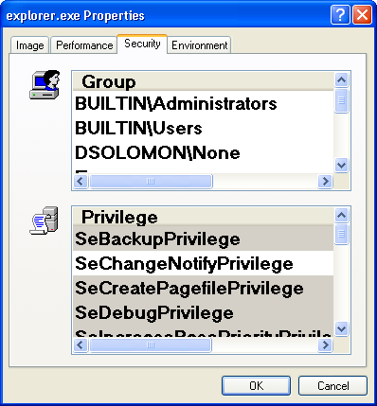
Security
Click on Security tab of process properties
Shows rest of access token (username is on image tab)
  Groups list
    Includes OS-assigned groups
  Privileges (user rights)
    Disabled by default
    Programs turn these on when needed
This is really a “Resultant Set of Groups” and “Resultant Set of Privileges” page

Slide 23
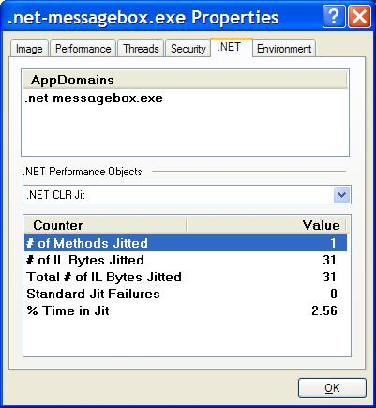
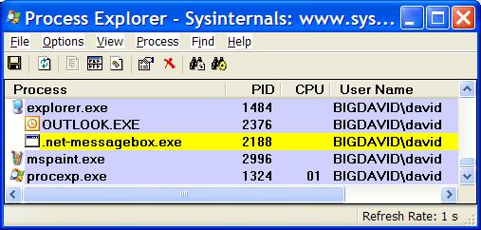
.NET Information
Process Explorer is aware of .NET processes
  Can highlight with Options->Highlight .NET Processes
Process properties have .NET tab
  Shows details about .NET process (CLR, Appdomains)
Can also add .NET-specific columns to process list

Slide 24
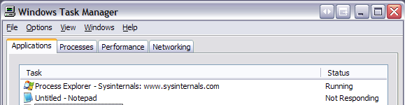
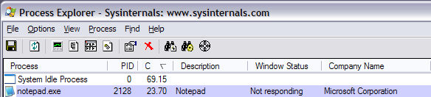
Windows Status
If you really like Task Manager’s Applications tab:
  Add the Window Title column
  Add the Window Status column
    Uses the same Windows function as Task Manager to determine status

Slide 25
Lab: Window Process Finder
Use the Window process finder toolbar button to identify the owner of a window
Lab:
  Open Regedit and modify HKLM\System\CurrentControlSet\Control\
  ProductOptions\ProductType
  Move the window process finder target over the resulting popup to see what process owns the window

Slide 26
Lab: Viewing Process Activity
1. Task Manager:
  Applications tab: find the process that owns a window (right mouse click on window title)
  Process tab: add a few additional columns: Virtual Memory size, Handle count, Thread count
    Windows 2000: add I/O counters; right click on a process & notice “end process tree” option
2. Look at process hierarchy with Process Explorer
  Start a command prompt, then run Notepad from command prompt, and find new process in process list
  Exit the command prompt and notice Notepad process moves to bottom of list since it has no parent

Slide 27
PS Tools
Group of 12 process/system control tools
  Where’d the “Ps” come from?
    The UNIX process listing tool is
    named “ps”
    The first PsTool was a UNIX “ps”-equivalent, PsList
They all work on Windows NT4/2000/XP/2003
They all work remotely as well as locally
  Require admin rights to remote system
    Can specify credentials with “-u” switch
None require manual remote software installation

Slide 28
PS Tools
Psfile – lists & closes remote file opens
Psshutdown – remote shutdown, lock workstation, log off user
Psexec – run an app on a remote system
Pslist – list processes & threads
Psuptime – system up time
Psinfo – display general system info
Psgetsid – displays computer or user SIDs
Psservice – service process control (like SC in XP)
Psloglist – dumps event log in text
PsSuspend – suspend a process
PsKill – kill processes
Psloggedon – lists local and remote logon sessions
Pspassword – change local/remote passwords

Slide 29
PsKill
The perfect complement to PsList
is PsKill
  Similar to Resource Kit Kill and Remote Kill
  See a process running on a remote (or local) system with PsList, kill it with PsKill
Unlike Task Manager, PsKill lets you kill any process if you’re an admin
  Uses “Debug” privilege
Uses auto-installed remote service and TerminateProcess API

Slide 30
PsList/PsKill Lab
Open a command prompt
Try Pslist on your machine
  c:\sysint\pslist
  c:\sysint\pslist –t (tree view)
  c:\sysint\pslist -s (autorefresh)
Look at process list on your neighbor’s machine
  c:\sysint\pslist \\computername
Kill Explorer.exe on your neighbor’s workstation
  c:\sysint\pskill \\computer explorer.exe

Slide 31
PsExec
Remotely execute programs
  Executes console programs interactively
  Allows you to start programs as yourself , in alternate user credentials, or in the System account
With PsExec you can:
  Launch a remote command prompt to effect
  a light-weight telnet
  Remote-enable “local only” command-line tools
  like IpConfig
Uses auto-installed remote service

Slide 32
PsExec Lab
Open a command prompt
Run Regedit under System account:
psexec -s -i c:\windows\regedit.exe
Start Notepad interactively on another workstation (or to yourself if not on a network):
  c:\sysint\psexec –i \\computer notepad.exe
  Find the Notepad process you created by examining the process tree with pslist on the remote system
    Notice parent service process

Slide 33
Lab Series 4.3.
The following labs capitalize on the materials presented in Section
“4.3. Windows Process and Thread Internals”

Slide 34
Process/Thread Kernel Debugger Commands
!process [/s Session] [Address/Pid [Flags]]
  !process – display current process (not full details)
  !process 342 – display full details of process 342
  !process 829fa030 – display process identified by EPROCESS address
  !process 0 0 – summary display of all processes
  !process 0 7 – full details of all processes
!thread [Address [Flags]]
  !thread – current thread
  !thread 826e8898 – display thread identified by ETHREAD address
To view user stack, must set process context:
  .process <address of EPROCESS>
  .context <address of page directory (Dirbase)>
!peb [Address]
!teb [Address]

Slide 35
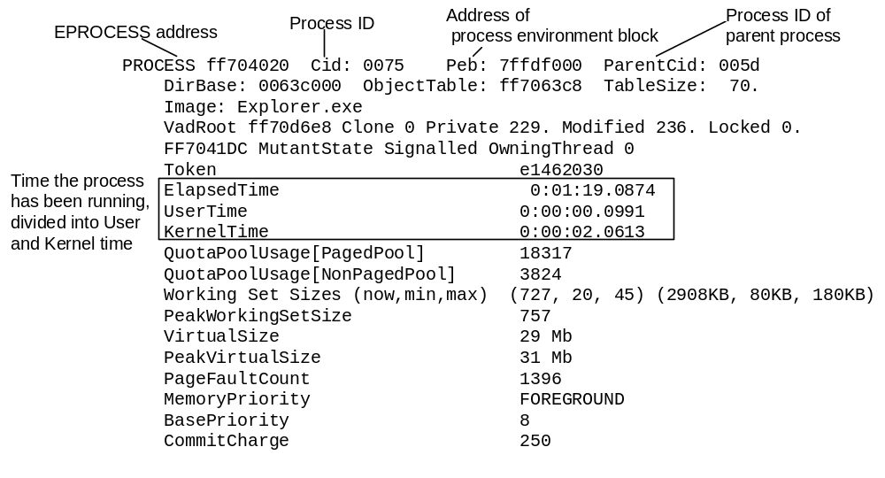
Process Block (!process)
Physical address
of Page Directory
root of the process’s
Virtual Address
Descriptor tree
Notes:
rev17b TODO: we should have a detail on the various option flags of !process and !thread.
rev17g2: added callouts for page directory and VADroot

Slide 36
Thread Block (!thread)
Thread ID
Process ID
Address of system
service dispatch table
Address of thread
environment block
Address of ETHREAD
THREAD 83160f60 Cid 9f.3d Teb: 7ffdc000 Win32Thread: e153d2c8
WAIT: (WrUserRequest) UserMode Non-Alertable
808e9d60 SynchronizationEvent
Not impersonating
Owning Process 81b44880
WaitTime (seconds) 953945
Context Switch Count 2697 LargeStack
UserTime 0:00:00.0289
KernelTime 0:00:04.0664
Start Address kernel32!BaseProcessStart (0x77e8f268)
Win32 Start Address 0x020d9d98
Stack Init f7818000 Current f7817bb0 Base f7818000 Limit f7812000 Call 0
Priority 14 BasePriority 8 PriorityDecrement 6 DecrementCount 13
Kernel stack not resident.
ChildEBP RetAddr Args to Child
f7817bb0 8008f430 00000001 00000000 00000000 ntoskrnl!KiSwapThreadExit
f7817c50 de0119ec 00000001 00000000 00000000 ntoskrnl!KeWaitForSingleObject+0x2a0
f7817cc0 de0123f4 00000001 00000000 00000000 win32k!xxxSleepThread+0x23c
f7817d10 de01f2f0 00000001 00000000 00000000 win32k!xxxInternalGetMessage+0x504
f7817d80 800bab58 00000001 00000000 00000000 win32k!NtUserGetMessage+0x58
f7817df0 77d887d0 00000001 00000000 00000000 ntoskrnl!KiSystemServiceEndAddress+0x4
0012fef0 00000000 00000001 00000000 00000000 user32!GetMessageW+0x30
Thread
state
Actual thread start address
Objects being
waited on
Address of user thread function
Priority Information
Stack trace
Notes:
rev17g2: fixed callouts for CID

Slide 37
Dumping Structures with Kernel Debugger
“dt” (“Display Type”) command can format most kernel structures
  Syntax: “dt StructureName address –r”
  dt nt!_* - displays all OS structures known to dt
  Note: relies on type information in symbol files
    Public symbols have this for XP, Windows Server 2003, and Windows 2000 SP4 and later
Process/thread-related structures:
  nt!_EPROCESS
  nt!_ETHREAD
  nt!_PEB
  nt!_TEB
  nt!_TOKEN
  nt!_JOB

Slide 38
Process Block Layout
lkd> dt nt!_EPROCESS
+0x000 Pcb : _KPROCESS
+0x06c ProcessLock : _EX_PUSH_LOCK
+0x070 CreateTime : _LARGE_INTEGER
+0x078 ExitTime : _LARGE_INTEGER
+0x080 RundownProtect : _EX_RUNDOWN_REF
+0x084 UniqueProcessId : Ptr32 Void
+0x088 ActiveProcessLinks : _LIST_ENTRY
+0x090 QuotaUsage : [3] Uint4B
+0x09c QuotaPeak : [3] Uint4B
+0x0a8 CommitCharge : Uint4B
+0x0ac PeakVirtualSize : Uint4B
+0x0b0 VirtualSize : Uint4B
.
.
NOTE: Add “-r” to recurse through substructures

Slide 39
Thread Block (!strct ethread)
lkd> dt nt!_ETHREAD
+0x000 Tcb : _KTHREAD
+0x1c0 CreateTime : _LARGE_INTEGER
+0x1c0 NestedFaultCount : Pos 0, 2 Bits
+0x1c0 ApcNeeded : Pos 2, 1 Bit
+0x1c8 ExitTime : _LARGE_INTEGER
+0x1c8 LpcReplyChain : _LIST_ENTRY
+0x1c8 KeyedWaitChain : _LIST_ENTRY
+0x1d0 ExitStatus : Int4B
+0x1d0 OfsChain : Ptr32 Void
+0x1d4 PostBlockList : _LIST_ENTRY
+0x1dc TerminationPort : Ptr32 _TERMINATION_PORT
+0x1dc ReaperLink : Ptr32 _ETHREAD
NOTE: Add “-r” to recurse through substructures

Slide 40
Lab Series 4.4.
The following labs capitalize on the materials presented in Section
“4.4. Windows Thread Scheduling”

Slide 41
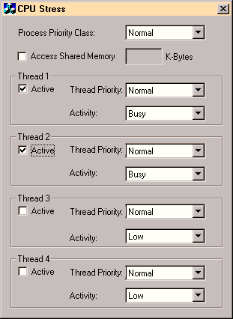
Watching
Scheduling
CPUSTRES.EXE -
Creating a Test Case
Run: cpustres.exe
(Resource Kit)
Screen snapshot from:
Run… cpustres

Slide 42
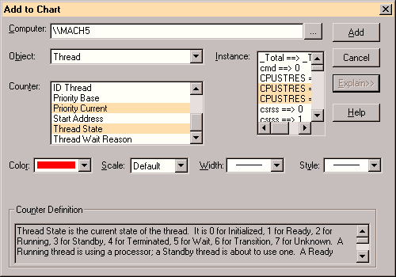
Watching the Scheduler
Performance Monitor - Threads Object
Screen snapshot from: Programs | Admin. Tools
| Performance Monitor select “Add to Chart”,
and Object: Thread. use Ctrl-leftClick to select
multiple items in a selection box

Slide 43
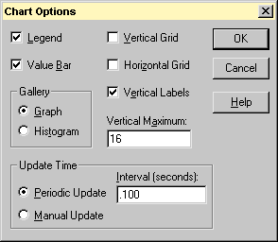
Watching the Scheduler
Performance Monitor - Options | Chart
Set chart maximum vertical scale to 16
Set update interval to 0.1 seconds or less
Screen snapshot from: Performance Monitor
Options menu | Chart command

Slide 44
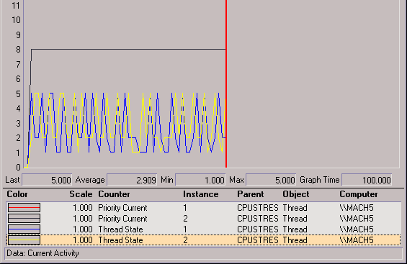
Watching the Scheduler
Performance Monitor
Thread states are indicated by numbers (see thread state transition diagram on previous slide, or Perfmon Explain display for Thread State counter)
5 = waiting
2 = running
1 = ready
Screen snapshot from:
PerfMon main window, setup from previous slide

Slide 45
Lab Series 4.5.
The following labs capitalize on the materials presented in Section
“4.5. Advanced Windows Scheduling”

Slide 46
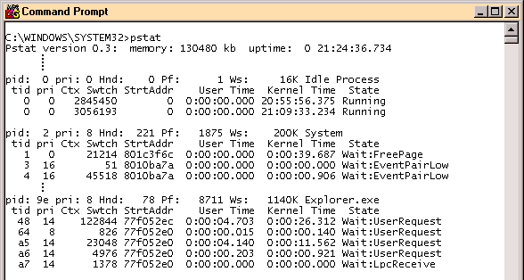
Looking at Waiting Threads
For waiting threads, user-mode utilities only display the wait reason
Example: pstat
To find out what a thread is waiting on, must use kernel debugger
Notes:
13d: new slide

Slide 47
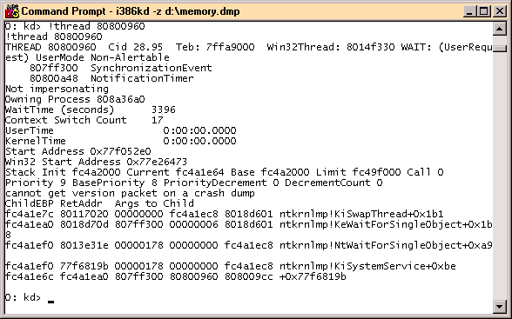
Looking at Wait Queues
!thread command to kernel debugger
  Lists addresses of objects being waited on (if a mutex, shows owner)
  !irpfind can search IRPs for an event object address
Notes:
13d: new slide
rev17jeh: Are those the wait block addresses or the actual object addresses? If the latter, !object will work
rev17a: object addresses (clarified text). IMO, !object isn’t terribly useful - doesn’t show much

Slide 48
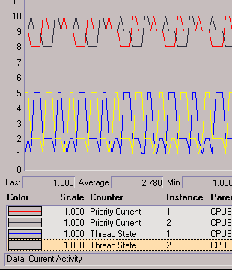
Priority Boost and Decay
Demo with CpuStres and PerfMon
CpuStres settings:
  two active threads
  activity level = busy (about 25% wait time)
  normal process priority class, normal thread priorities
Usually only visible in PerfMon if target app owns foreground window (hence longer quantum)
These are showing +2 boost (from 8 to 10) for foreground apps after wait completion

